Slide 1

SUPERCLUSTER SERIES
Tre Typer Klynger
// HOW-TO GUIDE //

Slide 2
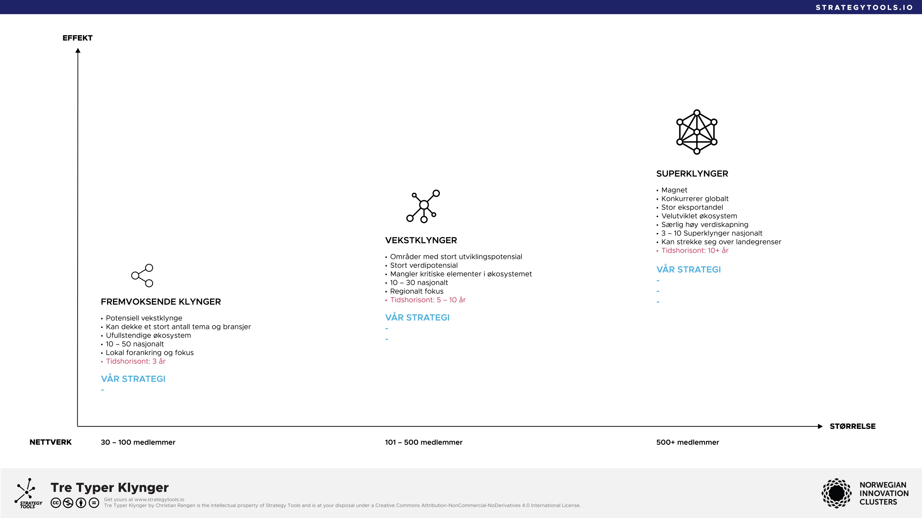

Slide 3
SUPERCLUSTER SERIES
Get more tools at strategytools.io
// HOW-TO GUIDE //

